Slide 1
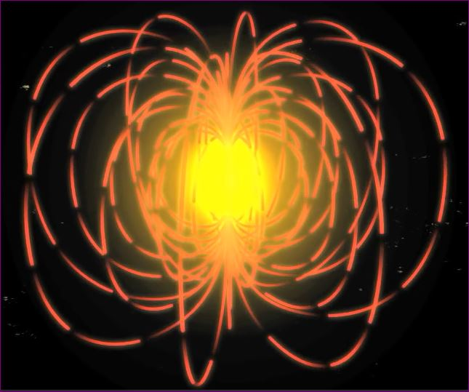
A single GANS / Plasma
Magnetical & Gravitational Fields of a Plasma
A plasma is made of millions and millions of fields that come together and spin continuously. Dynamic Field Interactions

Slide 2
Definition of GANS
GANS: A new state of matter; a molecule of a gas (GAs) which becomes (N)ano of itself and appears as (S)olid state of matter
GAs to Nano of Solid and to be called GANS for short

Slide 3
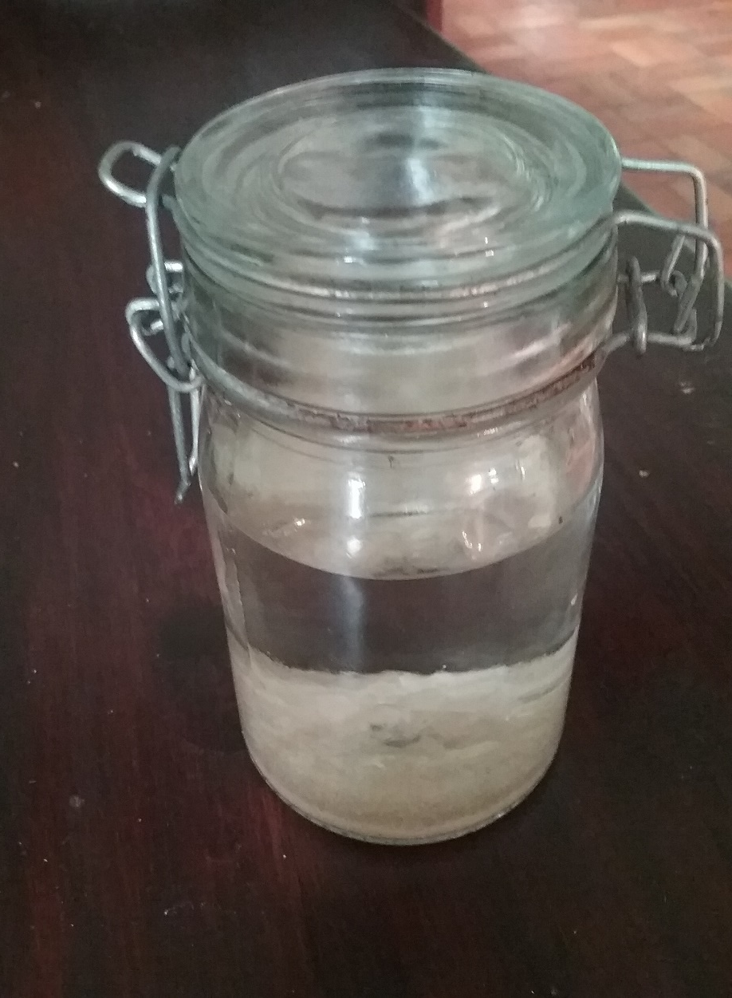
The Creation of CO2 GANS

Slide 4
List of Components Needed
Zinc plate
Nano Coated Copper plate
Plastic Box
Green LED light
Copper wire
Distilled water or Filtered Water
Pure salt NaCl
09/2017 v1.0jmd

Slide 5
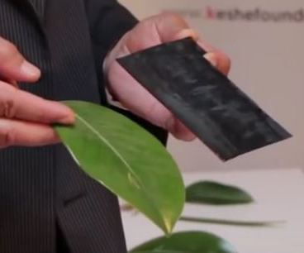
Nano Layered Copper plate. Please ensure this plate is washed well and does not contain any residue of the Caustic Soda. A Zinc Plate is needed.

Slide 6
Nano Layered Copper plate. Please ensure this plate is washed well and does not contain any residue of the Caustic Soda.

Slide 7
The two plates are representing the 2 sides of the leaf. Creates a Magnetical & Gravitational condition around the leaf which is equal to the MaGrav field of CO2 in the environment. Leaf creates condition to attract the fields of CO2 into the leaf structure.

Slide 8
The Nano Layered Copper plate and the Zinc plate are placed inside a plastic container. This creates the same Magnetical & Gravitational condition of the leaf

Slide 9
Connect the two plates with a wire to create a flow. But we have to control the current flow between the 2 plates.

Slide 10
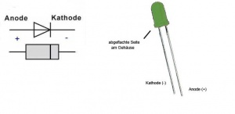
Led Light (Red or Green)
short
Connect a LED light to act as resistance to the flow of current.
Zinc Plate
Sea Water or
Distilled water with 3-4%% salt
Nano Copper Plate

Slide 11
Led Light
The environment between the two plates creates the MaGrav Field strength to attract Carbon.
When the Carbon comes into contact with the Water it Oxidises to form CO2
Zinc Plate
Carbon Field Zone
Nano Copper Plate

Slide 12
Led Light
With the LED / load between the plates we will be producing about 85% Co2 and 15% ZnO2
ZnO2
Zinc Plate
Carbon Field Zone
Nano Copper Plate
CO2

Slide 13
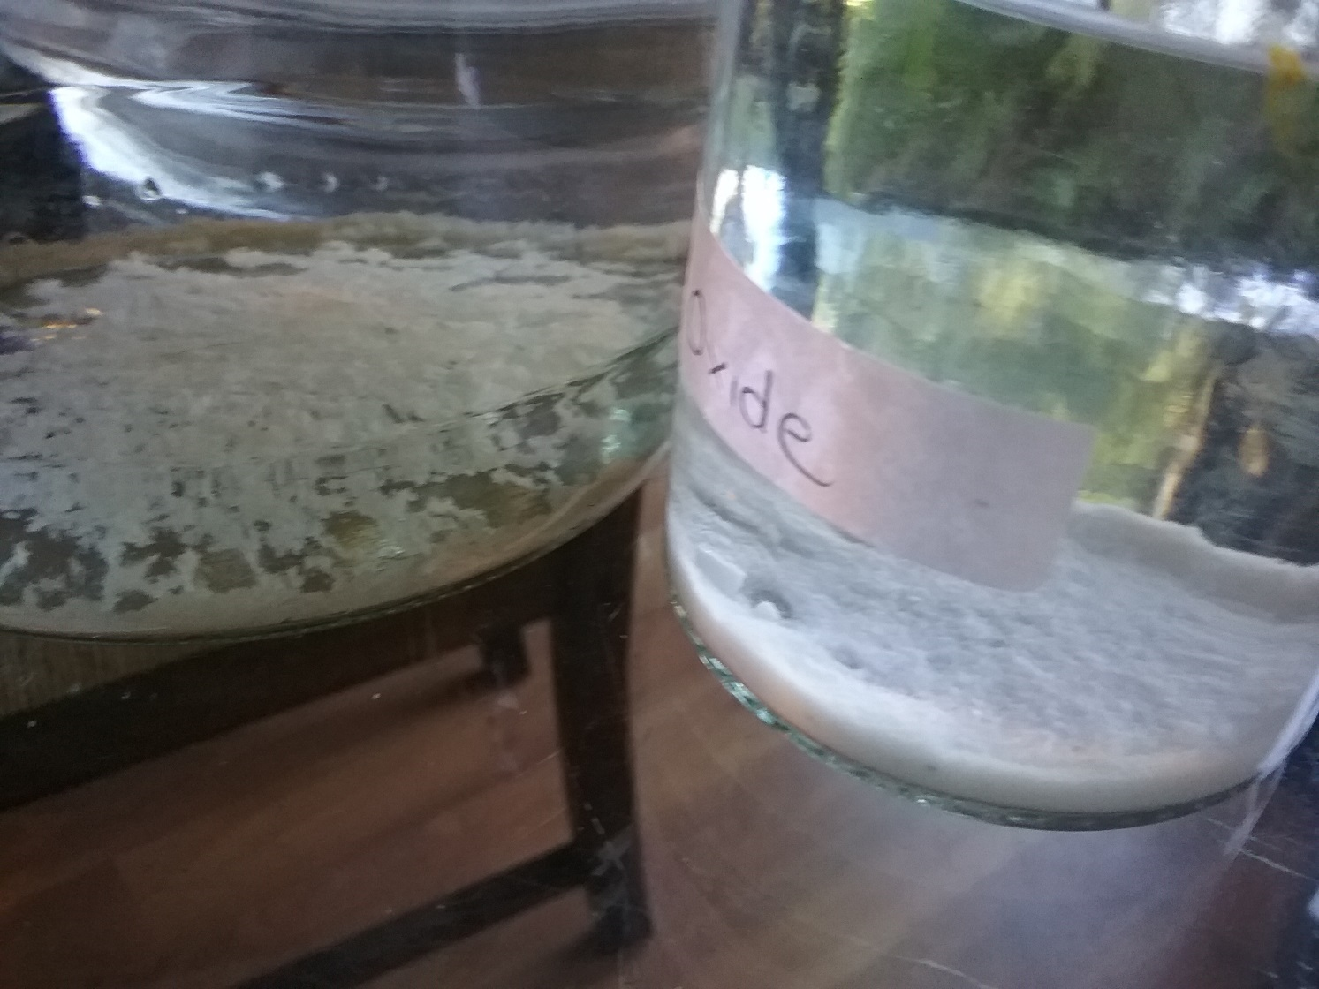
Over time you will notice a creamy white fluffy powder forming on the bottom of your container

Slide 14
Why do we use these Metal Plates?
 | Zinc | Copper | Nano Copper
Atomic Mass | 65 | 63 | 59 | Less 5%
 | 65 |  | 59
Difference |  |  | 6
We have now created a Gravitational Field strength difference of 6
Carbon has 6 Neutrons, 6 Protons & 6 Electrons
We need 50% of the fields (6 Neutrons) to attract the rest.
There is also a portion of graphene {carbon} on the layers of nano coating which gives plasmatic energy of carbon.
In summary we are creating and dictating an environment between the two plates of Carbon.
Carbon interacts with oxygen in water to create CO2

Slide 15
Extract this Co2 GANS with a syringe and place in a separate container

Slide 16
Washing of GANS
Once you have extracted all the CO2 GANS from the bottom of your container you need to start washing.
This collected GANS will still contain a high concentration of salt.
Add distilled water to your GANS and allow the CO2 to settle back down to the bottom.
Pour off the top water only and refill with more distilled water.
Repeat this at least 6 – 8 times to ensure the salt is washed out.
After the last rinse test the water from the top of the GANS to see if you taste any salt.
If you do continue to wash until no salt can be tasted

Slide 17
Collecting Amino Acids
After a few weeks you will notice a shiny layer on the surface of your water.
This is the amino acid of the CO2.
Take a plastic spoon and scoop this oil off and place in a separate jar. You do not need to wash this Amino Acid.

Slide 18
Liquid Plasma Water

Slide 19
Zinc GANS
This leads to high current flow, resulting in Zinc Oxide GANS
No LED / Load
CO2
90-95% ZnO2
&
5 -10% CO2
Zinc Plate
Plasmatic Environment
Nano Copper Plate
ZnO2

Slide 20
Copper GANS
Set-up to create the Copper GANS
Copper Plate
Distilled water with
5 - 10% salt
Nano Copper Plate

Slide 21
Zinc GANS
Set-up to create the Zinc GANS
Zinc Plate
Distilled water with
5 -10% salt
Nano Zinc Plate

Slide 22
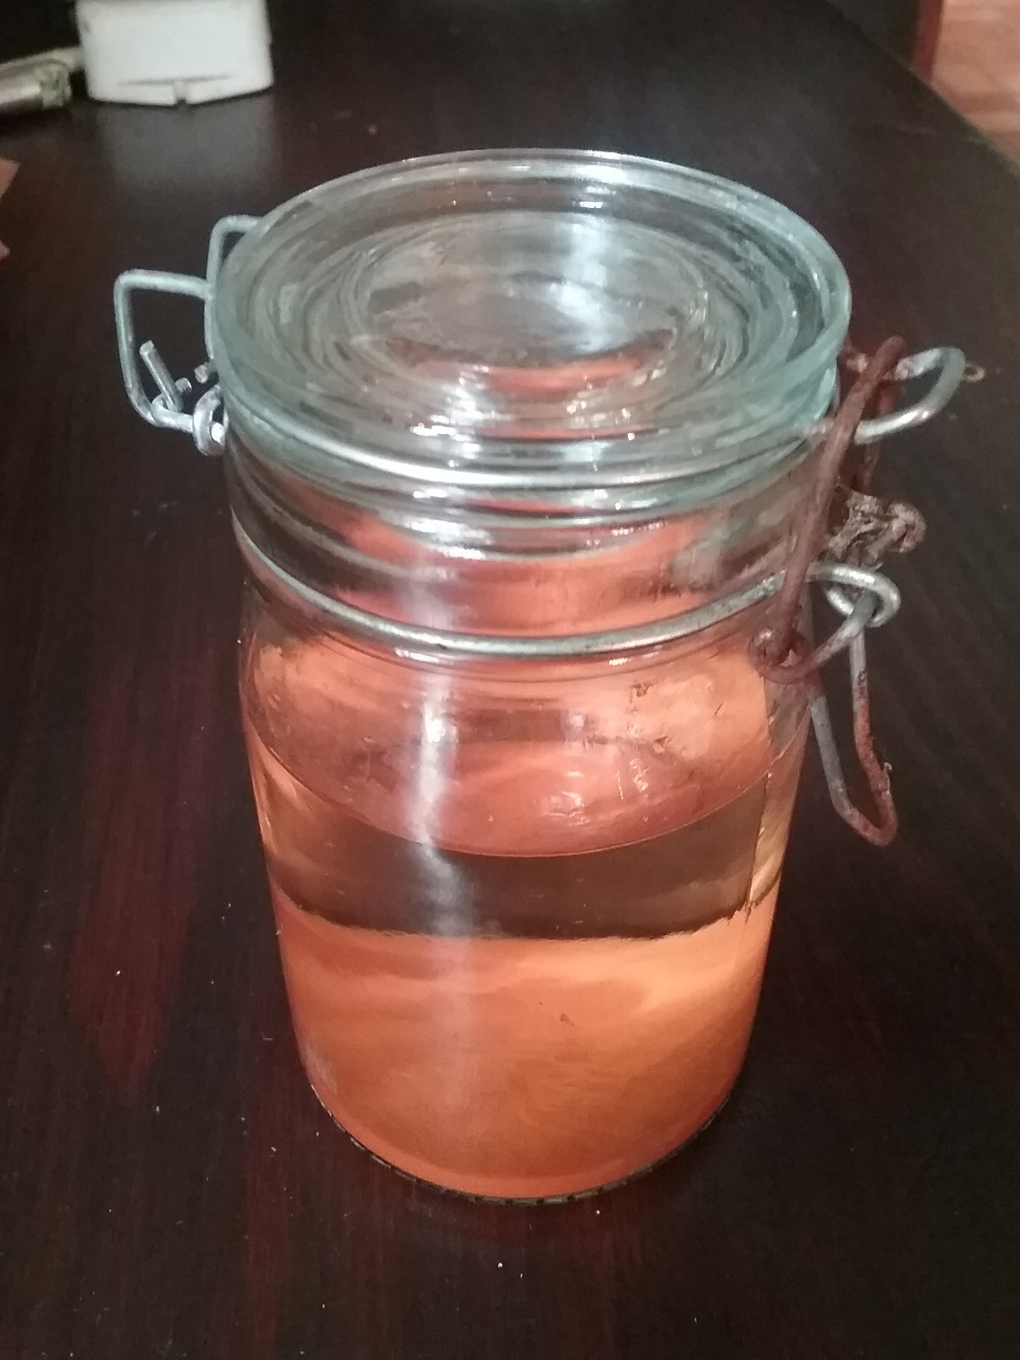
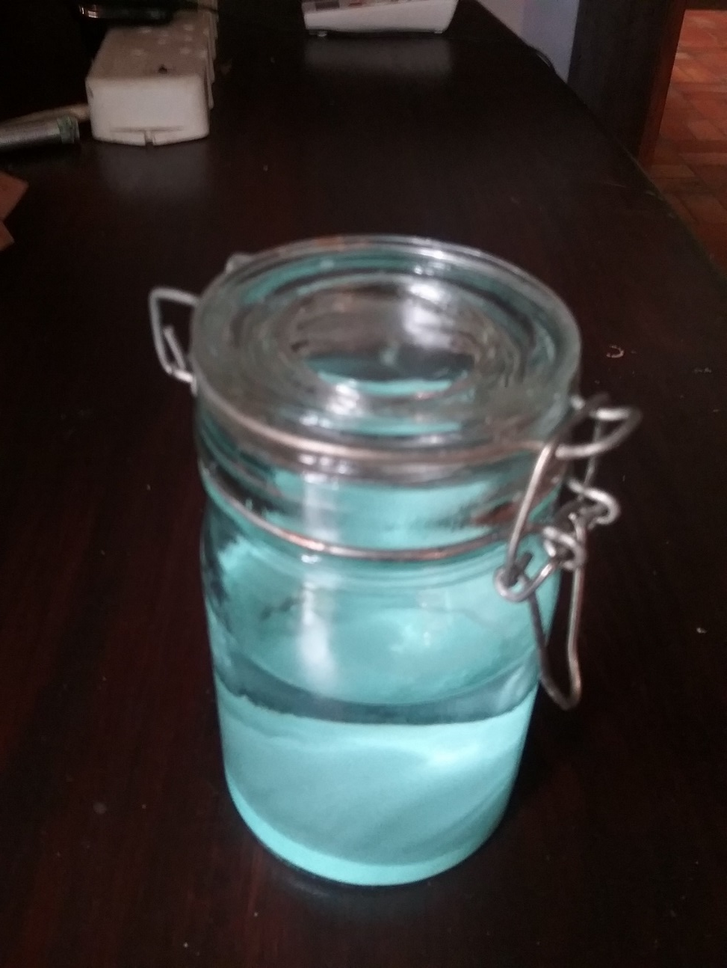
Four Main GANSes
CuO2
Co2
CH3
ZnO2

Slide 23
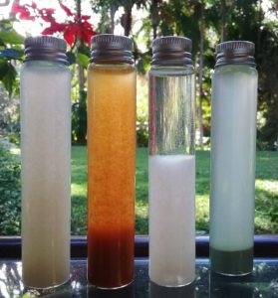
Each GANS will have its own MaGrav Field Strength We can now use these Fields in Energy, Health, Agriculture
CO2
CuO2
CH3
ZnO

Slide 24
FOUR MAIN GANSES USED IN HEALTH APPLICATIONS
CO2 ZnO2 CH3 CuO2
Each element matches with field strengths in the body.
Carbon is the connector and communicator
Oxygen is the gravitator
Hydrogen is the energy giver

Slide 25
CO2
Carbon – connection Oxygen – gravitator
Reconnects body and emotion, rebalance for health, pain relief.
Rebalances high energy states such as viruses and cancer or adds energy where required.
Incorporates Carbon 14 which has direct connection to the soul.
CO2 used in patches, drinking, all health devices.
Most fundamental and important GaNS for health.
Used in all Agriculture applications

Slide 26
CuO2 – Copper Oxide GANS
Lymph system connection.
Lymph system is in charge of the body processes.
It interacts with the muscle tissue and the nervous system
Disinfection.
Energy when making Magrav units

Slide 27
CH3
Carbon - connector. Hydrogen - energy.
Connected to blood and emotion, as well as energy levels.
CH3 is the basic sugar creating hydrogen energy.
Used in healing, feeding, Alzheimer's etc.
Used in agriculture

Slide 28
ZnO2
ZnO2 – zinc oxide.
Connected to the emotion.
Should be used in all health applications.
Emotions control the body.
Used in Agriculture

Slide 29
Trouble Shooting
You can adjust the distance between the zinc and the nano copper plate if you find you are not producing any CO2.
Percentage of salt can be adjusted to create a better result.
Do not add any form of power (battery or power supply) to the setup.
To confirm that you have CO2 GANS, place some in the freezer. The GANS does not Freeze.
09/2017 v1.0jmd

Slide 30
Your Intention when creating GANS
How you feel, your emotion at the time of setting up and making the GANS will have an impact on the final outcome.
Our thoughts and energy have a MaGrav Field which is transferred into the box and GANS material.

Slide 31
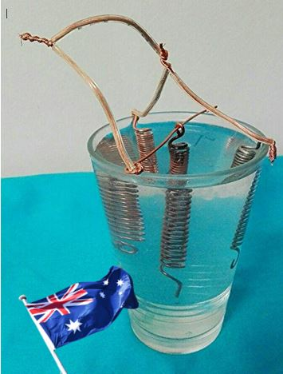
NEW GANSes
Cup of Life 1 for viruses
Cup of Life 2 as antibiotic

Slide 32
Coils add field interaction to the cup
You can use coils instead of plates for more complex fields of any GANS
Three coils also create a more complex combination of interactions

Slide 33
Amino Acids
Amino acids are important to add back into your GANS after washing.
Aminos add a closer connection to the body.
Aminos feed in a more well rounded way.
You can cheat by adding DRY GANS to an amino you may need to potentize it. E.g. vitamin D

Slide 34
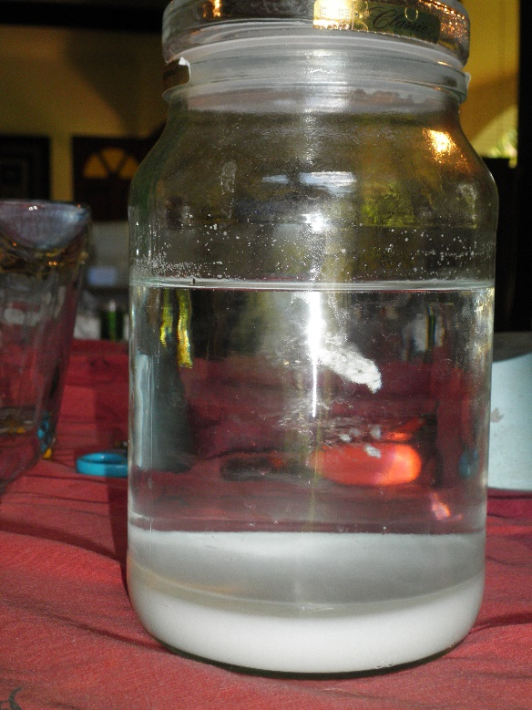
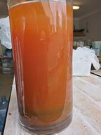
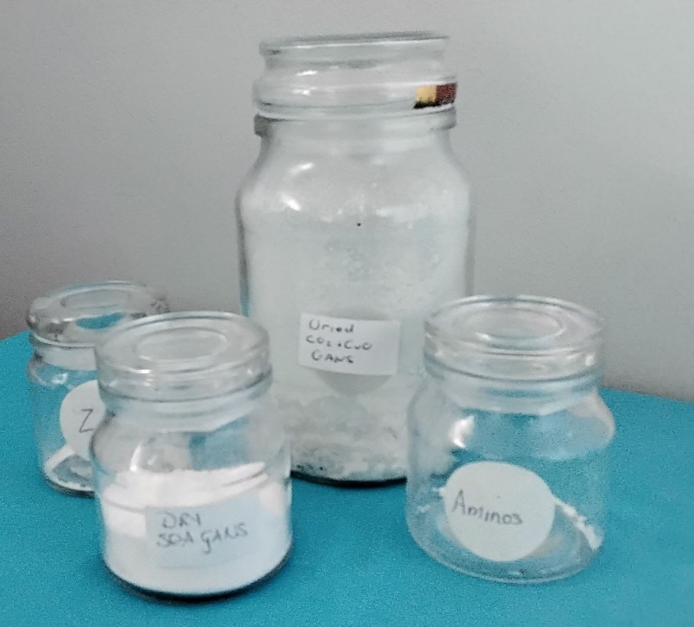
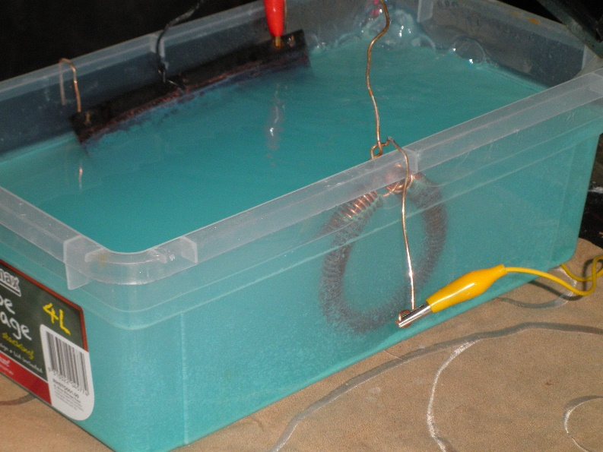
QUESTIONS

